Slide 1
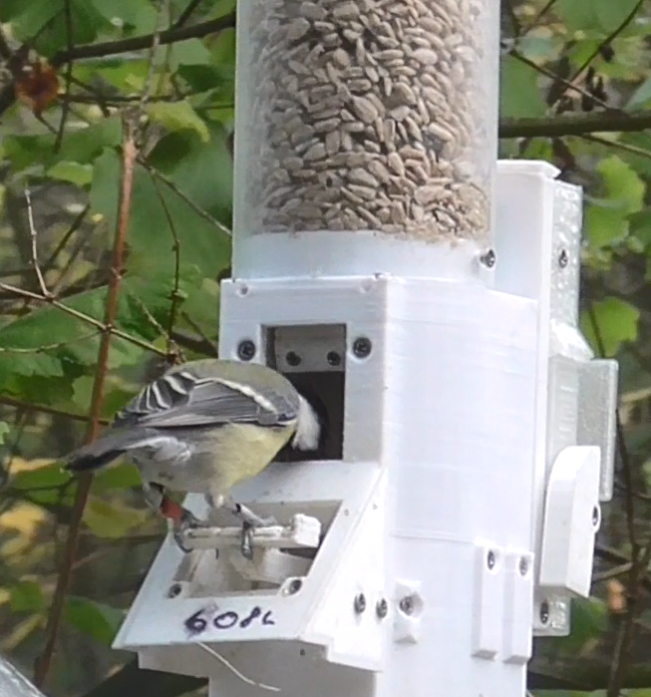
RFID WORKSHOP FOR ANIMAL BEHAVIOUR
Gabrielle Davidson
Gabrielle.Davidson@uea.ac.uk
ANGLIA RUSKIN UNIVERSITY 26 April 2023

Slide 2
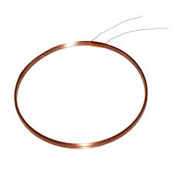
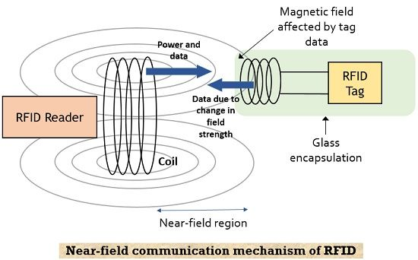
RADIO FREQUENCY IDENTIFICATION
Coil

Slide 3
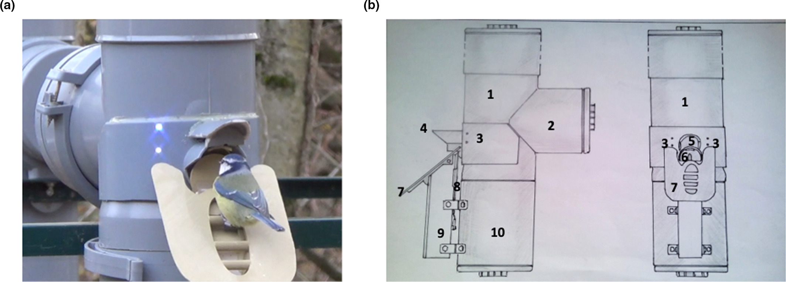
Placement of RFID coil matters
Cauchoix et al 202 Methods in Ecol & Evol

Slide 4
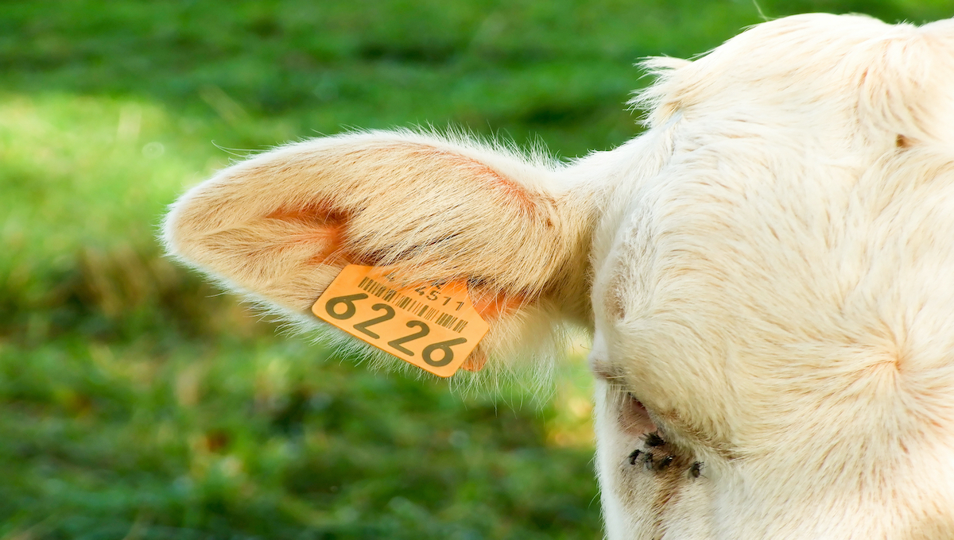
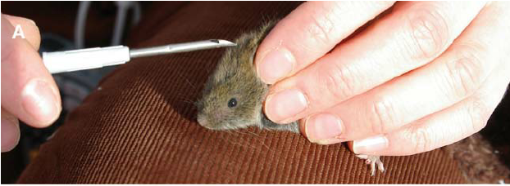
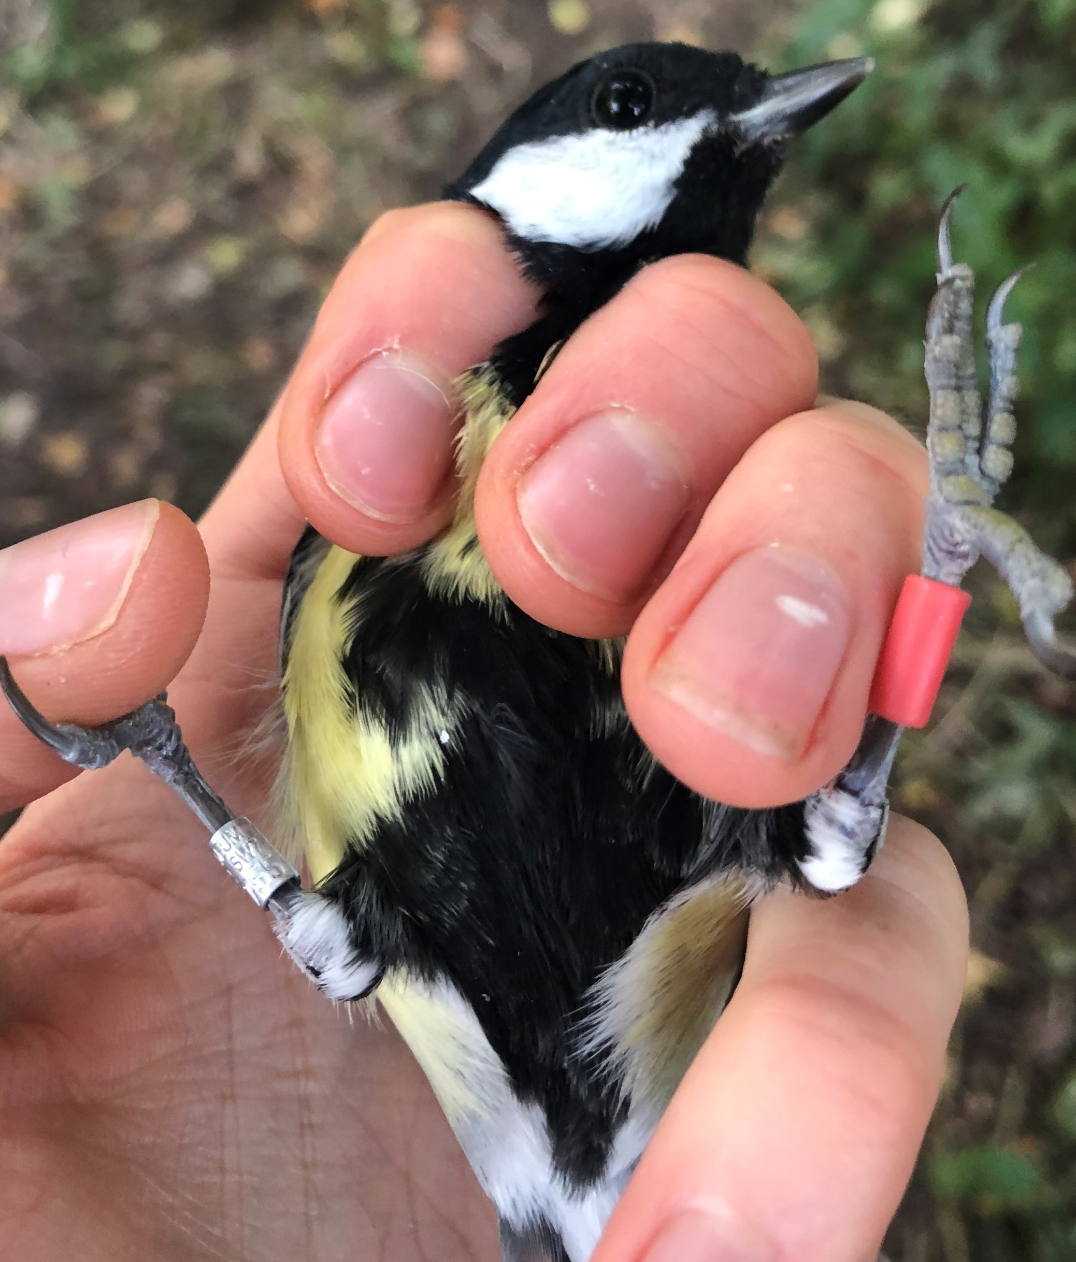
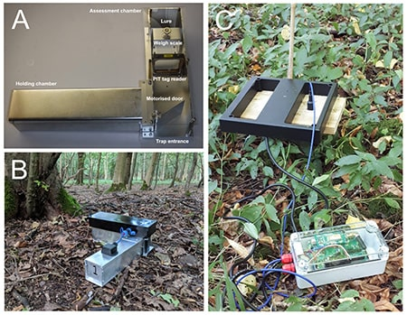
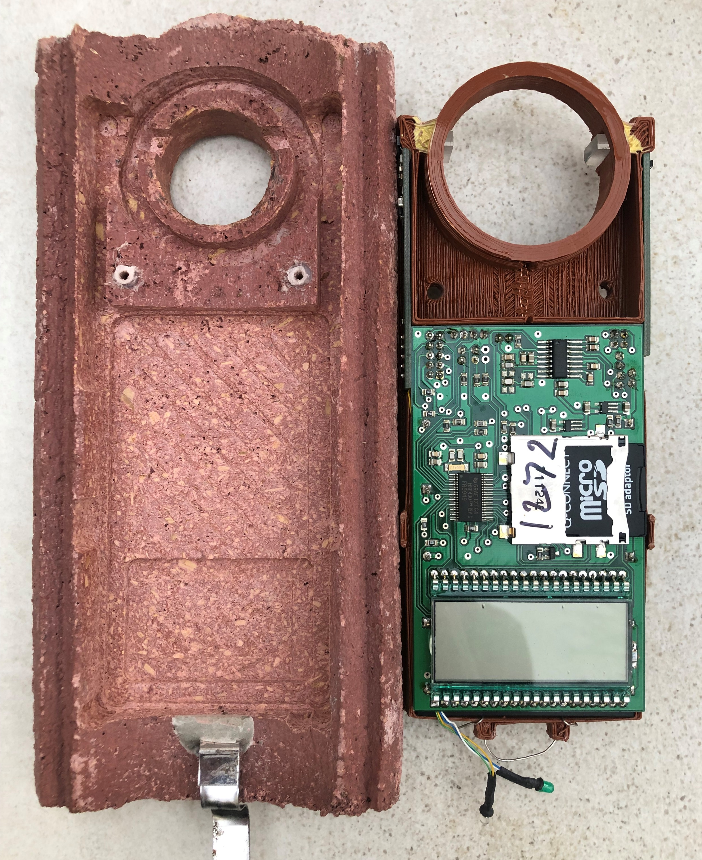
Applications
Knowles lab “intelligence trap”

Slide 5
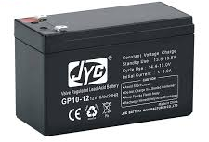
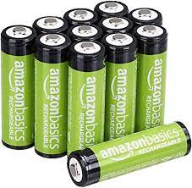
Battery life
The number of times the RFID signal repeats itself per second
Off period (night)
Secondary device to start the RFID antenna (photodiodes in nest box, strain gauge on feeder perch)

Slide 6
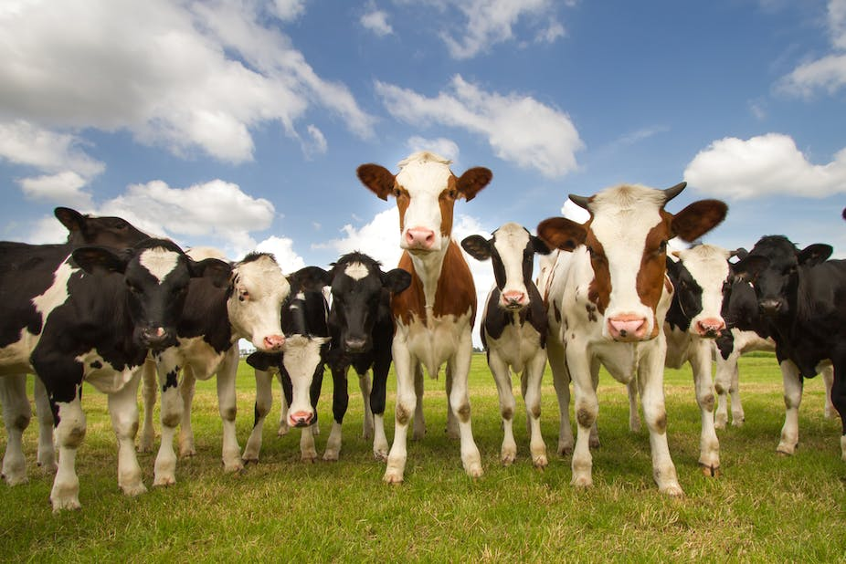
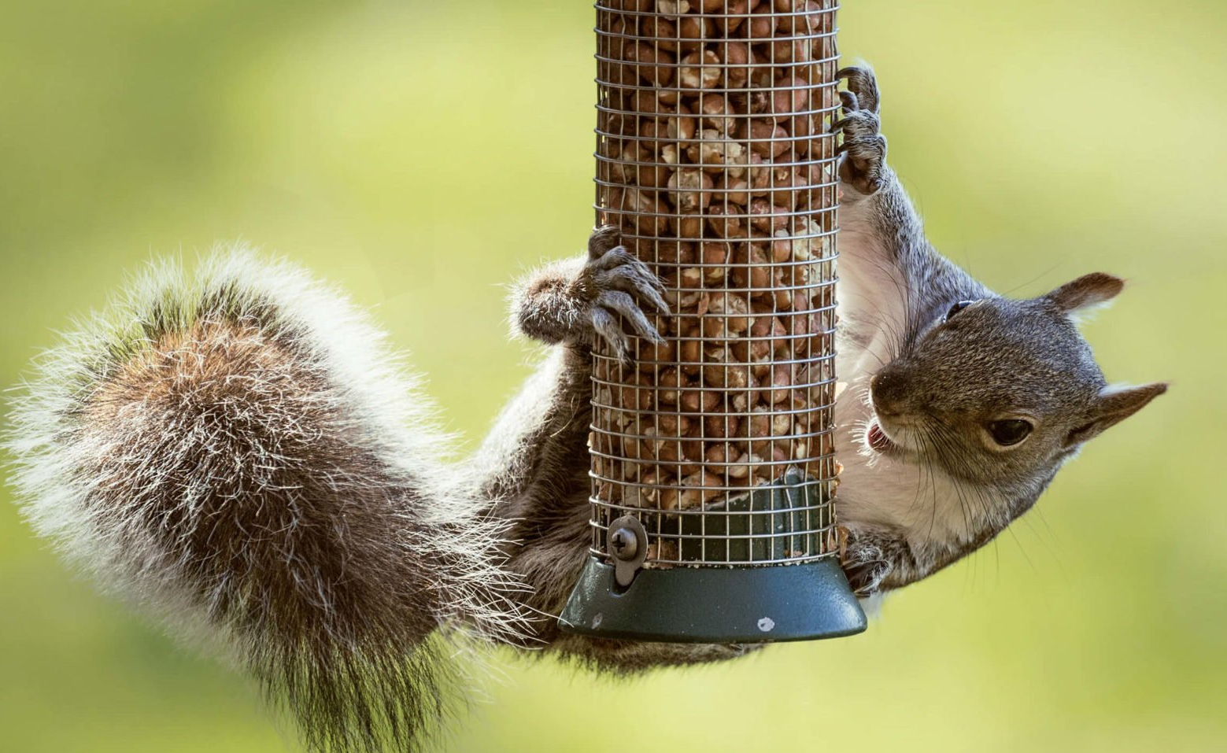
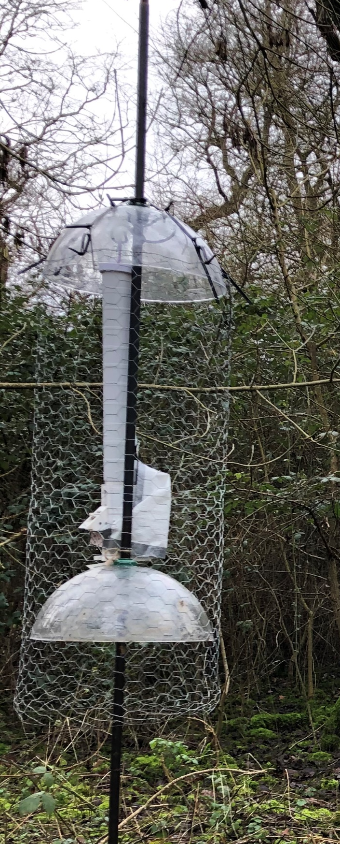
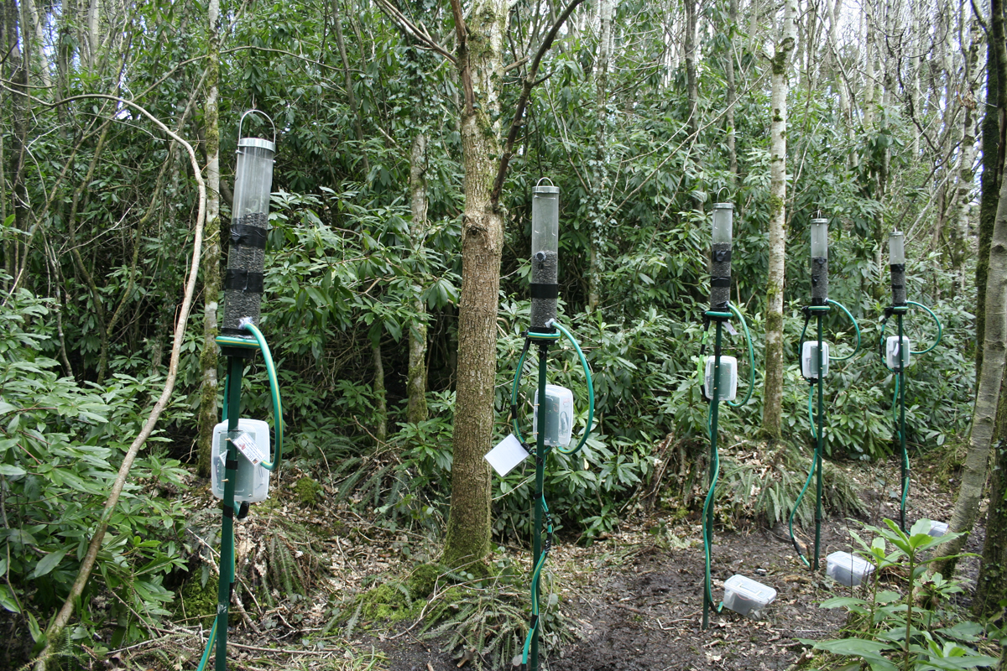
Protection
Water ingress
Casing design
Electronic board with Vaseline (censu Dominic Goodwin @ NatureCouters)
Unwanted animals
trample/chew feeders and wiring
Theft
Personal messages reduce vandalism and theft of unattended scientific equipment (Markus Clarin et al 2013 Methods Ecol Evol)

Slide 7
Data recording in the field
Naming system for RFID equipment
RFID name ≠ RFID position
SD card name ≠ RFID position
Date/time (laptop/manual display)
Log equipment failure
Device swaps common
Standardised file naming system (date as year/month/day)
Field notebook
Record which RFID name is in which position
Record time it was launched ( & log a ‘reference’ tag)
Record time data was saved
Record failures and swaps

Slide 8
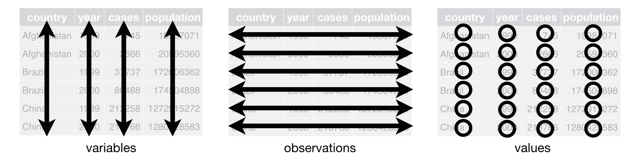
R software – some definitions
Objects: Objects contain stuff and have a name
Vectors: A sequence of elements all of the same data type (logical, numerical, character etc)
Dataframe: A data structure that organises data into a table. Dataframes have a mix of different data types in them. Each column in a dataframe is a different vector, and each row is a different element within the vectors.
Packages: R packages are a collection of R functions, compiled code and can contain sample data.
Functions: Perform operations in the programming language. Can contain multiple interrelated statements that are run together in a predefined order when the function is called. These are built-in or created by the user.
Arguments: The parameters provided to a function to perform operations

